Slide 1

Student survey data
Data analysis task
Presenting the findings

Slide 2
Student survey data
Data set
30 participants completed a survey which included the following questions:
Age
Average grade (at college)
Hours of TV watched (per day)
Hours of computer games played (per day)
Type of gaming console
Hours of homework completed (per day)

Slide 3
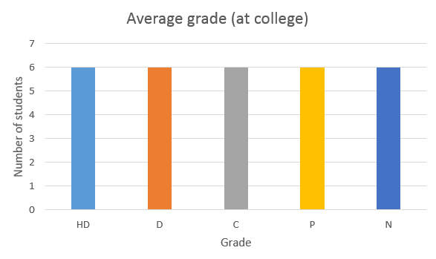
Student survey data
Participants
15 participants were female and 15 male.
The average grade of participants were evenly spread between grade levels.

Slide 4

Student survey data
Participants
Each participant owned a gaming console.
There were five types of console used.

Slide 5
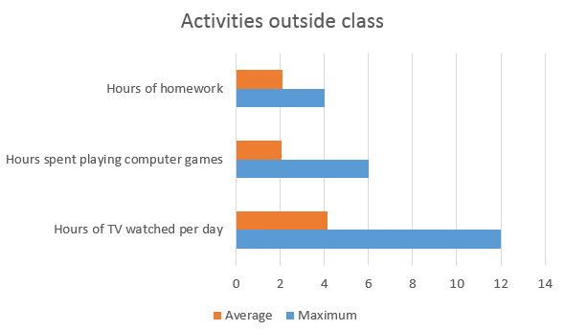
Student survey data
Outside the classroom
Participants spent on average per day:
2 hours completing homework
2 hours playing computer games
4 hours watching television (TV)

Slide 6
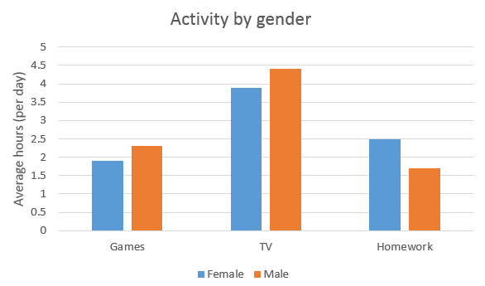
Student survey data
Activity by gender
When analysing the data further it was found that:
Males play games, and watch TV, more than females
Females complete more homework

Slide 7
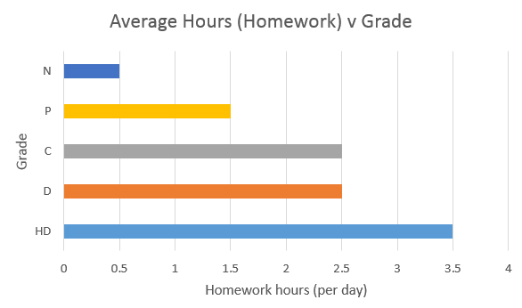
Student survey data
Average grade v homework hours
The more hours homework completed the better grades that were received.
HD students completed 3.5 hours
C students completed 2.5 hours
F students completed 0.5 hours

Slide 8
Student survey data
Average grade v gaming hours
The more hours spent gaming per day lead to lower grades:
HD students spent 0.5 hours gaming
C students spent 1.8 hours gaming
F students spent 4.5 hours gaming

Slide 9
Student survey data
Conclusion
Participants who completed more homework received better grades.
While those participants that spent longer periods of time playing games did not perform as well at college.
So, more study and less gaming!

